Slide 1

Road Sign and Road State Mobile Notification
Application
w/ GROUP 14

Slide 2
Task II Requirement gathering

Slide 3
Agenda
Introduction
Project Scope
Identification Of Stakeholders
Data Collection
Conclusion
References

Slide 4


Introduction What is Requirement gathering?...

Slide 5

define project scope
“Delivering road sign information and road state notification to drivers in a convenient and user friendly manner”

Slide 6

Identification of Stakeholders

Slide 7
Stakeholders
Primary Users
Drivers
2. Secondary Users
Passengers
Cyclists and Pedestrians
3. Data Providers
Government Agencies
Private Navigation Companies
4. App developers and maintainers
Software Developers
UI/UX Designers

Slide 8

Data Collection​
Interviews with stakeholders
Examination of an existing system
Brainstorming amongst project team members

Slide 9
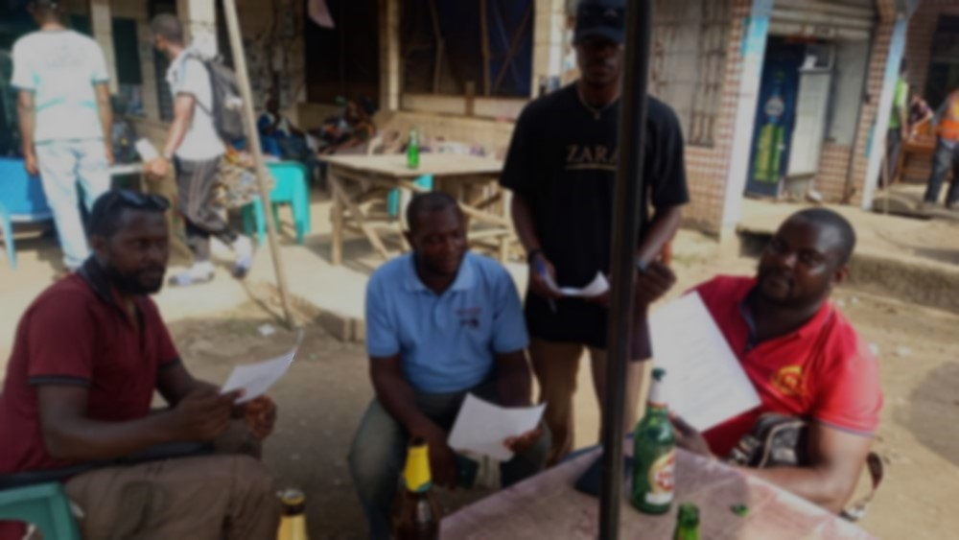
Interview with drivers

Slide 10
Core Functionalities:
Provide alerts for upcoming road signs (stop signs, speed limits, lane changes).
Offer navigation functionalities with traffic-aware routing.
User Interface and Experience:
Present a clear and user-friendly map interface.
Display traffic conditions visually (color-coded map, icons).

Slide 11
Personalization and Settings:
Offer user profiles with customizable preferences (map view, units).
Allow setting preferred routes (e.g., fastest, most scenic).
Advanced Features:
Display estimated travel times based on real-time traffic conditions.
Offer alternative route suggestions in case of traffic congestion.

Slide 12
interviews with Data providers
Real-time Traffic Information
User-Generated Road Sign Reports
Data Management and Verification
Transparency and User Feedback

Slide 13
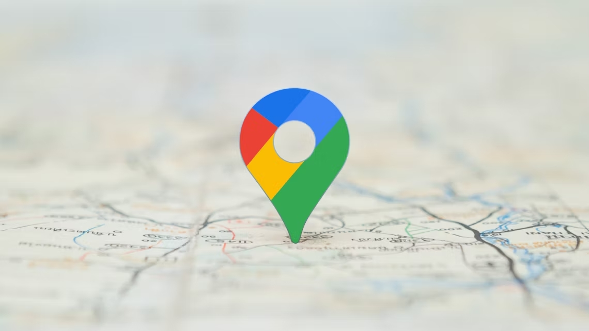
Examination of an existing system
CASE STUDY
Google maps
Waze

Slide 14
Google Maps
Benefits of Google maps
Accurate and up-to-date map data
Crowdsourced, real-time traffic data
Provides turn-by-turn directions for driving, walking, biking, and public transit

Slide 15
Limitations of Google maps
Limited offline functionality: Google Maps requires an internet connection to function properly, making it less reliable in areas with poor or no internet coverage.
Privacy concerns: Google Maps collects and stores data on users' locations and search history, raising privacy concerns for some users.

Slide 16
Waze
Benefits of Waze
Bright, colorful, easy-to-see icons
Crowdsourced traffic conditions mean better routes
Social connections for drivers

Slide 17
Limitations of Waze
Difficult to create directions from places other than your current location
No true offline options
Have to download maps every time when setting a route.

Slide 18
OUTCOME OF EXAMINING CASE STUDY
Enhanced Route Planning
Improved Offline Functionality
User Interface Refinement
Reduced Reliance on Real-Time Data

Slide 19
Brainstorming amongst project team members
Offer offline functionality for basic navigation and saved routes (optional).
Integrate with car connectivity platforms (Android Auto, Apple CarPlay) (optional).
Support multiple languages for international users.

Slide 20
Provide clear and easy-to-understand user documentation and tutorials.
Implement a user feedback mechanism for app improvement.
Offer text-to-speech conversion for all voice alerts and information.
Implement high-contrast themes for users with visual impairments.

Slide 21

conclusion
These requirements and user stories will guide the design and implementation of the Road Sign and Road State Mobile Application.
Further requirements may emerge as the project progresses.

Slide 22
references
https://www.geeksforgeeks.org/requirements-gathering-introduction-processesbenefits-and-tools/
https://www.geeksforgeeks.org/designing-google-maps-system-design/
https://www.nuclino.com/articles/functional-requirements
https://www.geeksforgeeks.org/non-functional-requirements-in-softwareengineering

Slide 23
Members
NAME | MATRICULE
ABO STEVE AKUM | FE21A125
CHINEPOH DIVINE-FAVOUR | FE21A159
JENNA EBOT AGBOR | FE21A205
LANGEH MOHAMMED YIENEH | FE21A223
NDEH TAMINANG | FE21A246

Slide 24

Thank you
Github: https://github.com/Langeh03/Group14

